Slide 1
Adalberto Ruiz
University of Advancing Technology
Network Security, SIP

Slide 2
Technical Field & Background Information
This project involves the technical fields of digital and physical security. Working at Amazon’s Global Security Operations Center, this project helped improve the efficiency of Amazon’s physical and digital security.
This project was inspired by the COVID-19 pandemic and the thought of saving lives. The improvement of generalized efficiency through auto deploying tools saved or aided in preventing the death of approximately 32,000 lives on a month-by-month basis and saved the organization approximately $312,000 monthly.

Slide 3
Project Description
While the initial goal of this project was focused on improving the efficiency of physical and digital security by instantly deploying tools you would need at your workstation, I’ve also found this project/tool useful for attacking every day digital security breaches at home or while on the job. This project aims to create a tool that deploys useful programs or workplace website based tools that you may need on-the-fly. The end goal is to improve efficiency metrics for metric based organizations or job functions.

Slide 4
Innovation Claim
This project is innovative because it saved or prevented the death of approximately 32,000 lives on a month-by-month basis while saving the business approximately $312,000 monthly. This is also an on going project which will be deployed throughout Amazon’s Global Security Operations Center, which will improve the efficiency of crisis management and incident response in life-threatening or disaster recovery situations.

Slide 5
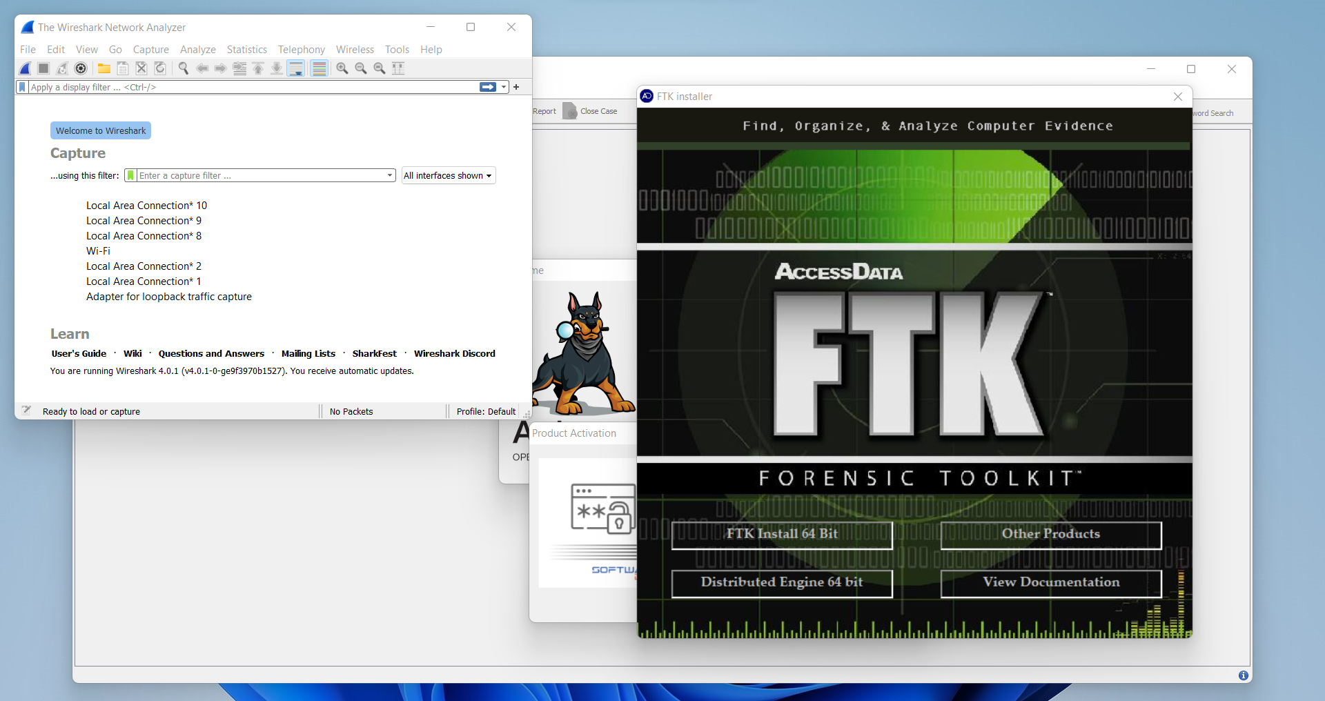
Insert image, sketch/prototype or rendering of idea here.

Slide 6
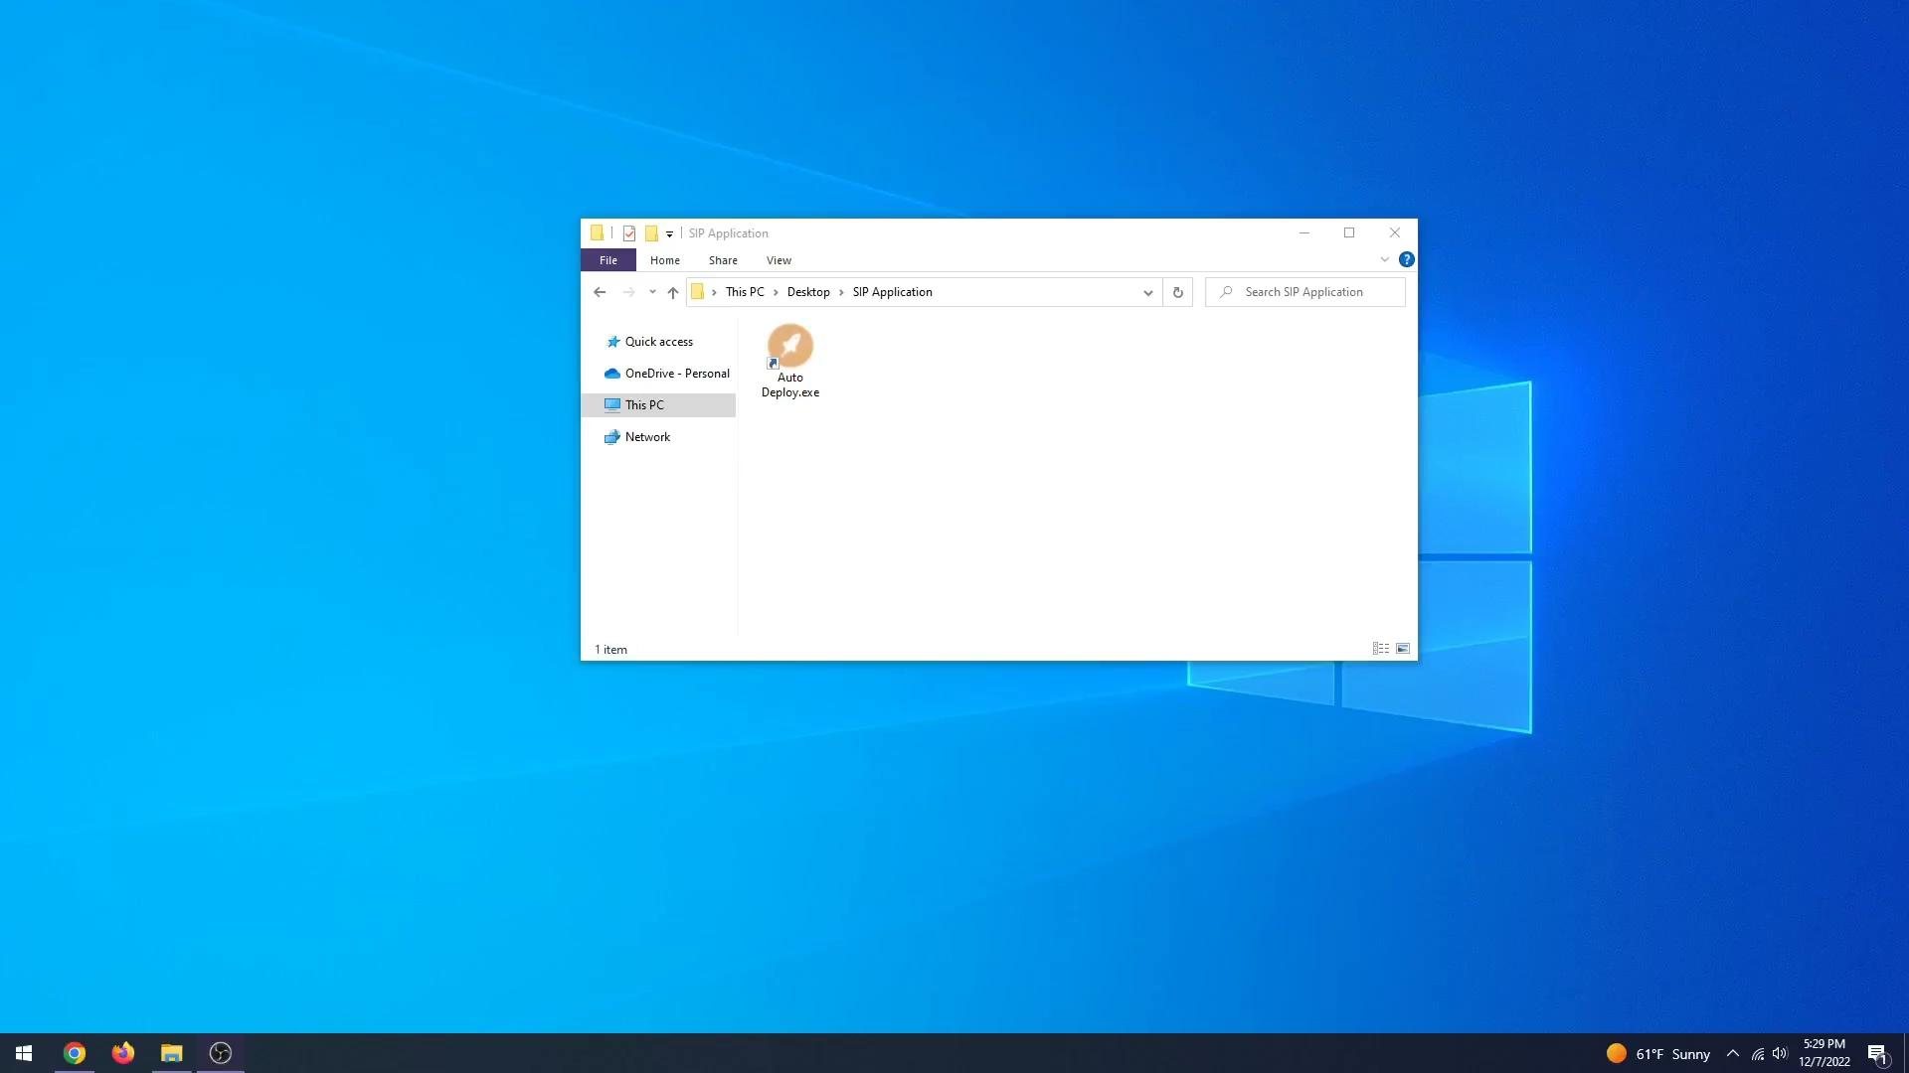
Autopsy, Encrypted Disk Detector, Network Miner, Hash My Files, Nmap, NFI Defraser, etc.

Slide 7
Target Market
The target market for this project is organizations with massive ongoing job work loads, consisting of tools needing to be reset or job functions utilizing different online/digital tools for different tasks throughout the day.
An example of this is my workplace. Amazon’s Global Security Operations Center.

Slide 8
Prior Art
Ninite - https://ninite.com/
Used for installing/updating applications on the fly

Slide 9
Q&A
f
Adalberto Ruiz - Network Security
Innovation Claim: This tool, when applied to high paced job functions or readiness response situations, has the potential of saving lives and saving an organization thousands of dollars through getting the appropriate resources and support within seconds.

