Slide 1
SP 800-58
Security Considerations for Voice Over IP Systems
By: Adalberto Ruiz
University of Advancing Technology

Slide 2
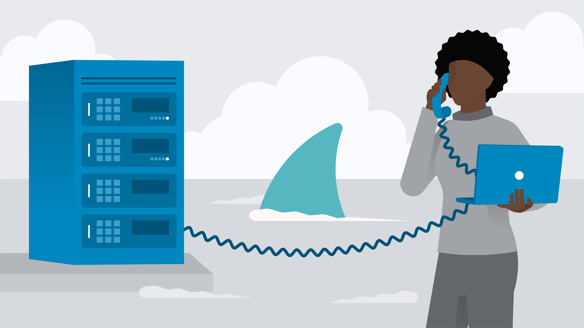
Purpose of SP 800-58
As mentioned in the document previously, the main goal of SP 800-58 is to provide agencies with guidance for establishing secure VoIP networks. Every business/organization is highly encouraged by SP 800-58 to tailor the recommended guidelines to meet their specific agencies requirements. A setting where SP 800-58 should highly be enforced and upheld would be any small to large organization with the intent to establish Voice over IP connections with outside parties.

Slide 3
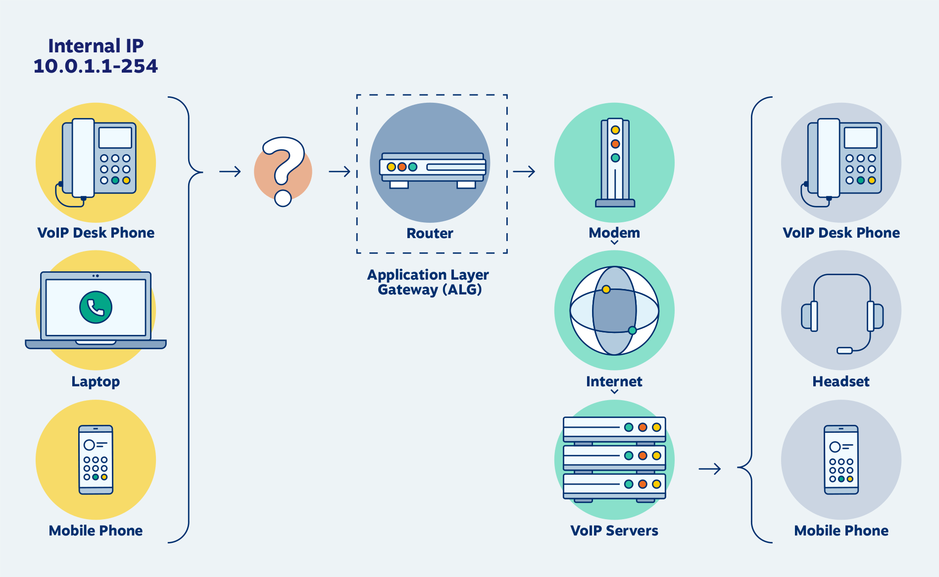
Scenario of when to enforce SP 800-58
You are working at a small family owned attorney office downtown. There is a very valuable up and coming case your team has been working on that can possibly win them thousands in a lawsuit. The only problem your team faces is that you suspect the opposing attorneys are tapping into your phone calls. Your reasoning behind this is that you’ve seen them suspiciously walking by your office a few times peeking in during business hours. This network’s cabling oddly runs throughout the exterior of the building. As a side note, your VoIP system is currently having router bottlenecking issues.

Slide 4
Proposed Solution based on SP 800-58
According to SP 800-58, if you’re having suspected eavesdropping throughout your calls, you may be using the improperly configured transport protocol. As you check what protocol you’re running you notice that RTP (Real-time Transfer Protocol) is being used throughout your VoIP connections. The solution SP 800-58 gives is to configure the use of SRTP (Secure Real-time Transfer Protocol). After doing this the bottle neck is slightly reduced, but is continuously present. According to SP 800-58, common router bottleneck issues are typically found at the encryption process in the data link layer. To fix this you change encryption to be solely at the endpoint of the router. You test for the bottleneck issue again and your router’s bottleneck issue is gone.

Slide 5
Requisitioned equipment and/or personnel
Network Administrator Why? Propper configuration and switch from RTP to SRTP Is required throughout all the network’s VoIP devices.
Physical layer Network Engineer/Building Renovators Why? All cabling must be rerouted from the exterior of the building towards the interior. Cables/routers/switches should not be accessible to anyone outside of the organization’s facility to meet bare minimum security standards.
Security Auditor Why? Audits must be done to ensure best possible security, and to cover any obvious vulnerabilities that may have been looked over.

Slide 6
Tentative Implementation Timeline
Cable rerouting - Small family owned business shouldn’t take too long to reroute basic cabling. Small renovations may need to be done. 7 Days allotted.
Proper and secure Network configuration - Small network with a only few basic devices (Phone, PCs, Routers, etc.) employees use often. 2 Days allotted.
Security auditing - Should not take over a day since network configuration was done a day prior, checklist and guidelines are ran through easily. 1 Day allotted.
Total of 10 days allotted to implement.

Slide 7
Employee security training
Human error is commonly known as the biggest vulnerability to any business. Proper security training and office hygiene training should be done for every employee working with confidential information. These rules should also be followed in compliance to HIPAA guidelines. Every employee will be well versed in security regarding all of the following categories. -Phishing -HIPAA -Passwords -Office Hygiene -The privacy Act -General Data Protection Regulation -Ransomware -PCI Security standards -Fraud

Slide 8
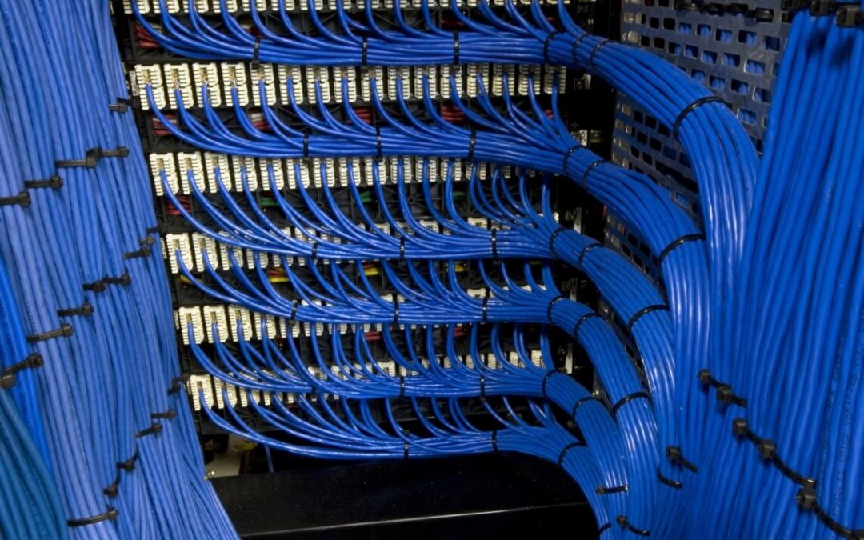
Total implementation cost
Most Basic Security Auditing - $5,000
Network VoIP reconfiguration - $1,000
Cable rerouting $1,500
Security course training for all working employees - $10,000
Total security implementation cost: $17,500

Slide 9
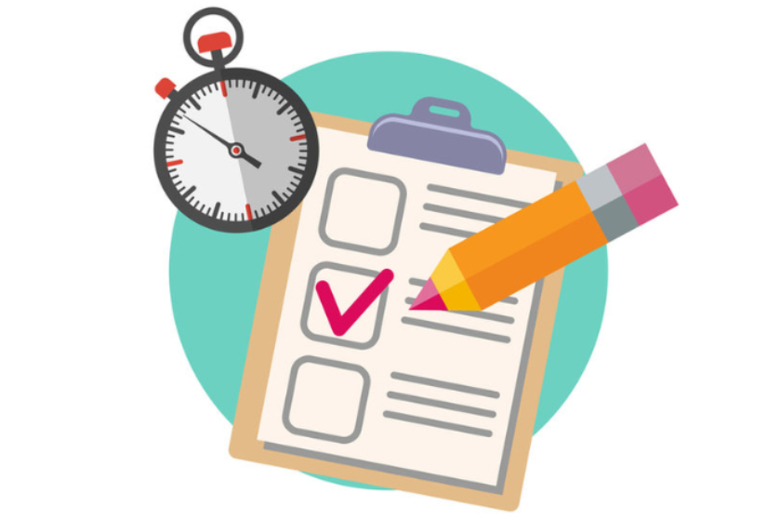
Evaluation system
The initial evaluation will be performed by the auditor hired to audit our network. After that our evaluations will be based off of our firewall results and more importantly our employee’s experience while performing everyday tasks. Once a problem arises again an evaluation of the general network are will be performed again, however there will not be a full audit performed.

Slide 10
Benefits
-No need to worry about obvious network security flaws moving forward
-All of the employees will be properly trained and focused ensuring your business isn’t breaking any legal guidelines
-Voice over IP connections will be securely established and will have much less bottlenecking throughout the VoIP connection in general.
-Saving possible hundreds of thousands of dollars in legal fees (Data Breach, HIPAA violations, etc.)

Slide 11
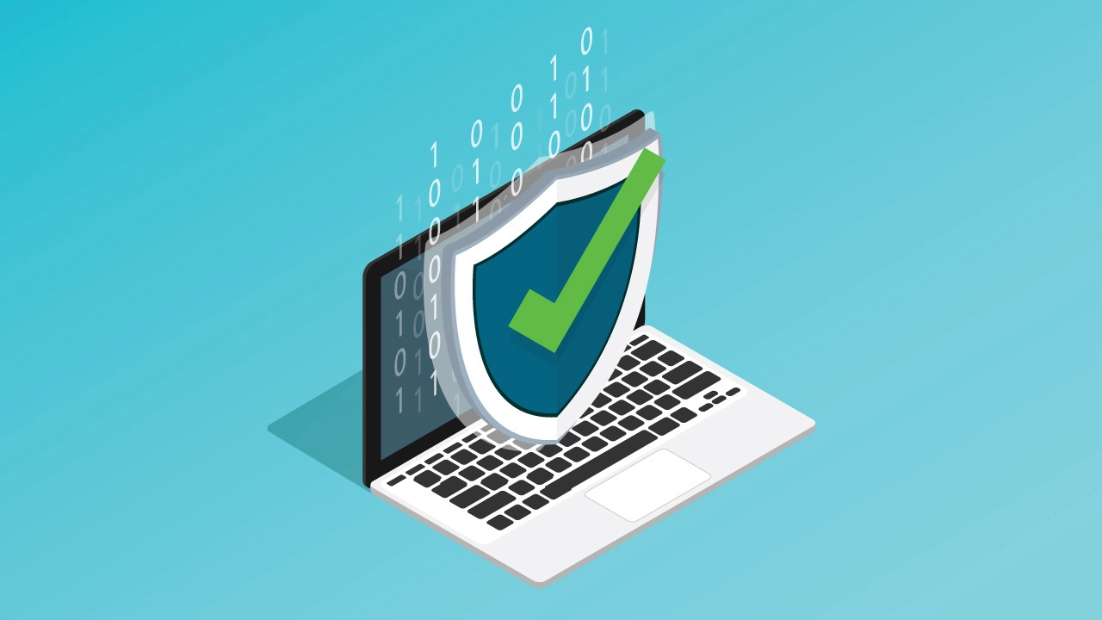
Conclusion
Every business or organization of any size needs a properly configured physical network and Voice over IP configuration. Criminals may abuse VoIP vulnerabilities within your network to obtain confidential information throughout your phone calls that can be used to self benefit illegally. This can result in fees that can cost hundreds of thousands of dollars, however implementing a proper security plan for your organization can save you from this tragedy. It’s always better to invest a few thousand dollars in order to prevent a possible six figure loss for your organization.

Slide 12
Resources used:
Messmer, E. (2007, October 01). Top 14 VoIP vulnerabilities. Retrieved April 6, 2021, from https://www.networkworld.com/article/2286358/top-14-voip-vulnerabilities.html
Kuhn, R., Walsh, T., & Fries, S. (2005, January 01). Security considerations for voice over ip systems. Retrieved April 4, 2021, from https://csrc.nist.gov/publications/detail/sp/800-58/final
D. (2005). Security Considerations for Voice Over IP Systems. Retrieved from https://nvlpubs.nist.gov/nistpubs/Legacy/SP/nistspecialpublication800-58.pdf
Voip vulnerabilities. (2020, November 20). Retrieved April 5, 2021, from https://en.wikipedia.org/wiki/VoIP_vulnerabilities
How much does it cost to secure a network? (n.d.). Retrieved April 14, 2021, from https://www.turn-keytechnologies.com/blog/article/how-much-does-it-cost-to-secure-a-network/#:~:text=A%20full%20network%20audit%2C%20which,several%20thousand%20dollars%20to%20%2420%2C000.
McCarver, M., & Manager, C. (2020, January 09). VoIP firewall - its place in your network ⋆ SANGOMA. Retrieved April 6, 2021, from https://www.sangoma.com/articles/voip-firewall/
McCarver, M., & Manager, C. (2020, January 09). VoIP firewall - its place in your network ⋆ SANGOMA. Retrieved April 4, 2021, from https://www.sangoma.com/articles/voip-firewall/

