Slide 1
Security Program
Adalberto Ruiz University of Advancing Technology

Slide 2
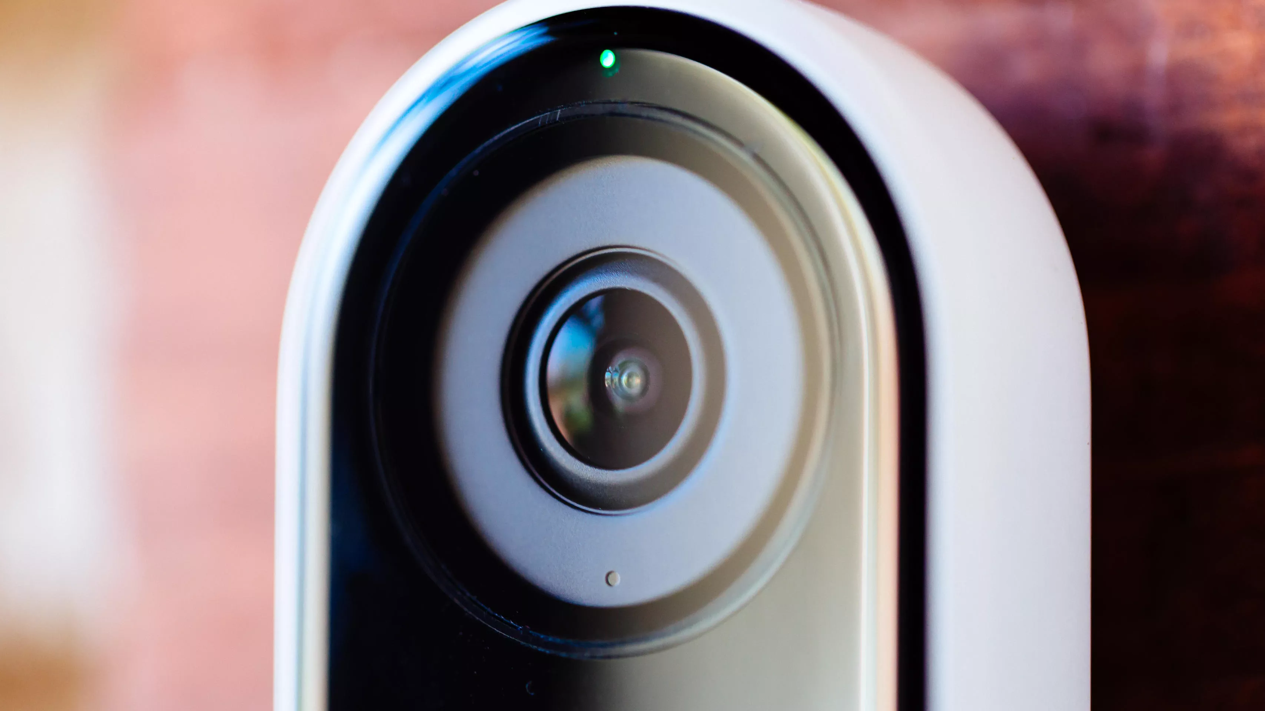
Physical Security
-Employee security awareness training
-Logs of every company device coming in and out of the building
-Having hard drive / SSD backups of our information in a secure area
-Requiring every employee to use Smart Key Cards to enter the building with logs
-Getting physical security guards is also a great physical security tactic, because the guard can monitor everything through cameras

Slide 3
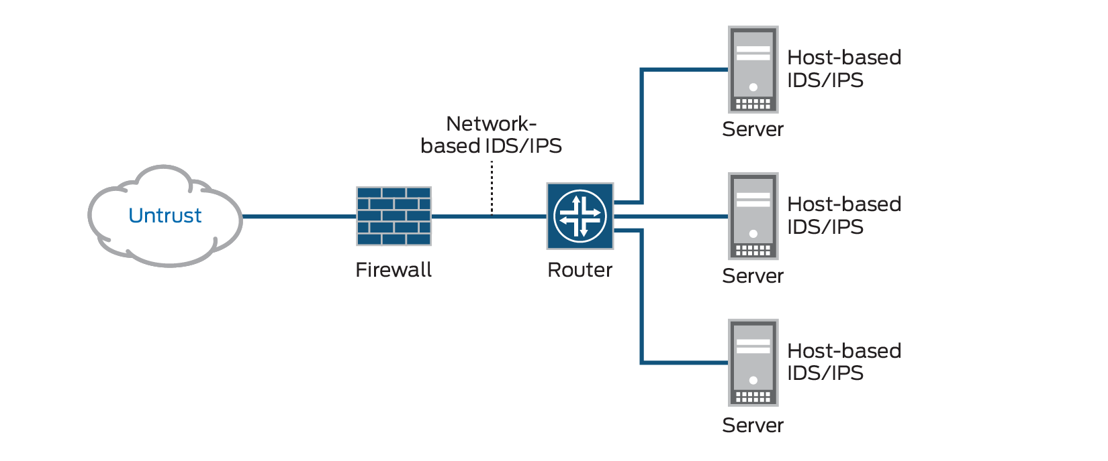
Digital security
-Intrusion Detection and prevention systems have lots of benefits 1. Monitors network activities 2. Monitors system activities 3. Detects possible intrusions 4. Network behavior analysis -Another useful measure of security is a firewall. Firewalls can 1. Monitor system traffic 2. Blocks trojans 3. Stops keyloggers 4. Stops botnet attacks These are NOT guarantees, but it makes performing a breach much more difficult

Slide 4
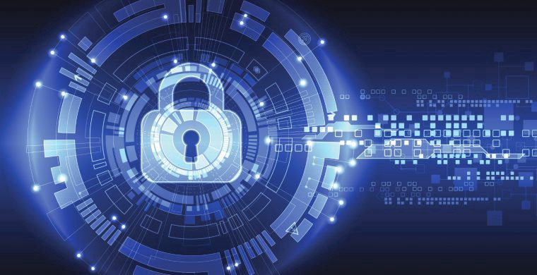
Cryptography
-Cryptography has 3 main goals with your sensitive data 1. Protect the confidentiality of your data 2. Preserve the integrity of your data 3. Allow full access to the authorized data users
-Decrypting something can take hundreds or even sometimes thousands of years through brute forcing attempts
-If anyone gets into your database, it’ll be really difficult to know what to decrypt and slow their process down

Slide 5
Conclusion
While these are ways that we can improve our security, it doesn’t always mean that they’re guarantees. As an example, physical security will not prevent against botnet attacks. They also will not prevent against brute forcing password attempts. While a firewall will prevent digital attacks, it will not prevent against someone stealing the hard drives and SSDs. You need digital security and physical security to keep your data secure. Employee training will also help out to prevent breaches through social engineering. All these have one goal in mind, and that’s to prevent all attacks as best as each layer of security can.

Slide 6
Resources
When It Comes to Cyber Security, Consider Physical Cyber Security Defenses. (2017, July 25). Retrieved April 24, 2020, from https://innovationatwork.ieee.org/physical-cyber-security-defenses/ McDunnigan, M. (2019, January 10). What Roles Do Firewalls & Proxy Servers Play in Network Security? Retrieved April 24, 2020, from https://itstillworks.com/roles-firewalls-proxy-servers-play-network-security-2630.html Pearson IT Certification. (n.d.). Retrieved April 24, 2020, from https://www.pearsonitcertification.com/articles/article.aspx?p=2218577&seqNum=3

